Slide 1
Roaming photo booth rental Anaheim
https://sites.google.com/view/luckyfrogphotoboothrental/home
Notes:
https://sites.google.com/view/luckyfrogphotoboothrental/home
https://drive.google.com/drive/folders/15iVJMcD9RBjeoRp702ZgApgdfNWV_Njf?usp=sharing
https://news.google.com/rss/search?q=videobooth
https://drive.google.com/drive/folders/1ufl3IueIKIwdfaGrD-0Wd2u2dc38JTJc?usp=sharing
https://drive.google.com/drive/folders/1TlyfeH3TH3rSLFwHnDSxpKSHOZa4El02?usp=sharing
https://drive.google.com/drive/folders/1ffAC0p76IQQFzXpO4MH8SFRsh8WWFDtp?usp=sharing
https://drive.google.com/drive/folders/1nHr6fh9XRvUNqhbuIVXQ4HTFJr69-SkG?usp=sharing
https://drive.google.com/file/d/1ZC83rHwcmG1qM8c9i34hNF5jHCkGZEOG/view?usp=sharing
https://drive.google.com/file/d/1EOa9-xoFKVwc4-VmWjZPWjVVe27CYzzc/view?usp=sharing
https://drive.google.com/file/d/140vDlT7WZfFAJAS0k5WdWn2TxHGW9blj/view?usp=sharing
https://drive.google.com/file/d/1KQtXuwQ-55wMsk5zYouUtQRq0G1xmzEb/view?usp=sharing
https://docs.google.com/spreadsheets/d/1ACa5DWdtZ95va9b8xA8fZRaLzwPfGEXiYhGOdJMNBcs/edit?usp=sharing
https://docs.google.com/spreadsheet/pub?key=1ACa5DWdtZ95va9b8xA8fZRaLzwPfGEXiYhGOdJMNBcs
https://docs.google.com/spreadsheets/d/1ACa5DWdtZ95va9b8xA8fZRaLzwPfGEXiYhGOdJMNBcs/pubhtml
https://docs.google.com/spreadsheets/d/1ACa5DWdtZ95va9b8xA8fZRaLzwPfGEXiYhGOdJMNBcs/pub
https://docs.google.com/spreadsheets/d/1ACa5DWdtZ95va9b8xA8fZRaLzwPfGEXiYhGOdJMNBcs/view
https://docs.google.com/forms/d/1wTKbkAx3F0x4QirWo7taJnT3sleqCy0P8SL3ROS4Gk0/edit?usp=sharing
https://docs.google.com/drawings/d/1hOHNtTLsdGC6b-XHon36fFT08CMtaWGXYJQqGe9ofNs/edit?usp=sharing
https://drive.google.com/file/d/1tpnxuW89TUi11jKtDR9JDr08CDxHmMk0/view?usp=drivesdk
https://sites.google.com/view/roamingphotoboothrentla/home
https://docs.google.com/document/d/11Yb6mCIkuzOoCps-k6WVYbABFcBtu9CFw7I2_bdoBfg/edit?usp=sharing
https://docs.google.com/document/d/11Yb6mCIkuzOoCps-k6WVYbABFcBtu9CFw7I2_bdoBfg/pub
https://docs.google.com/document/d/11Yb6mCIkuzOoCps-k6WVYbABFcBtu9CFw7I2_bdoBfg/view
https://docs.google.com/presentation/d/1KDnBq3Rk15s2iyUan2ErF5m4GRcI1q04636zISlJOEk/edit?usp=sharing
https://docs.google.com/presentation/d/1KDnBq3Rk15s2iyUan2ErF5m4GRcI1q04636zISlJOEk/pub?start=true&loop=true&delayms=3000
https://docs.google.com/presentation/d/1KDnBq3Rk15s2iyUan2ErF5m4GRcI1q04636zISlJOEk/view
https://docs.google.com/presentation/d/1KDnBq3Rk15s2iyUan2ErF5m4GRcI1q04636zISlJOEk/htmlpresent

Slide 2
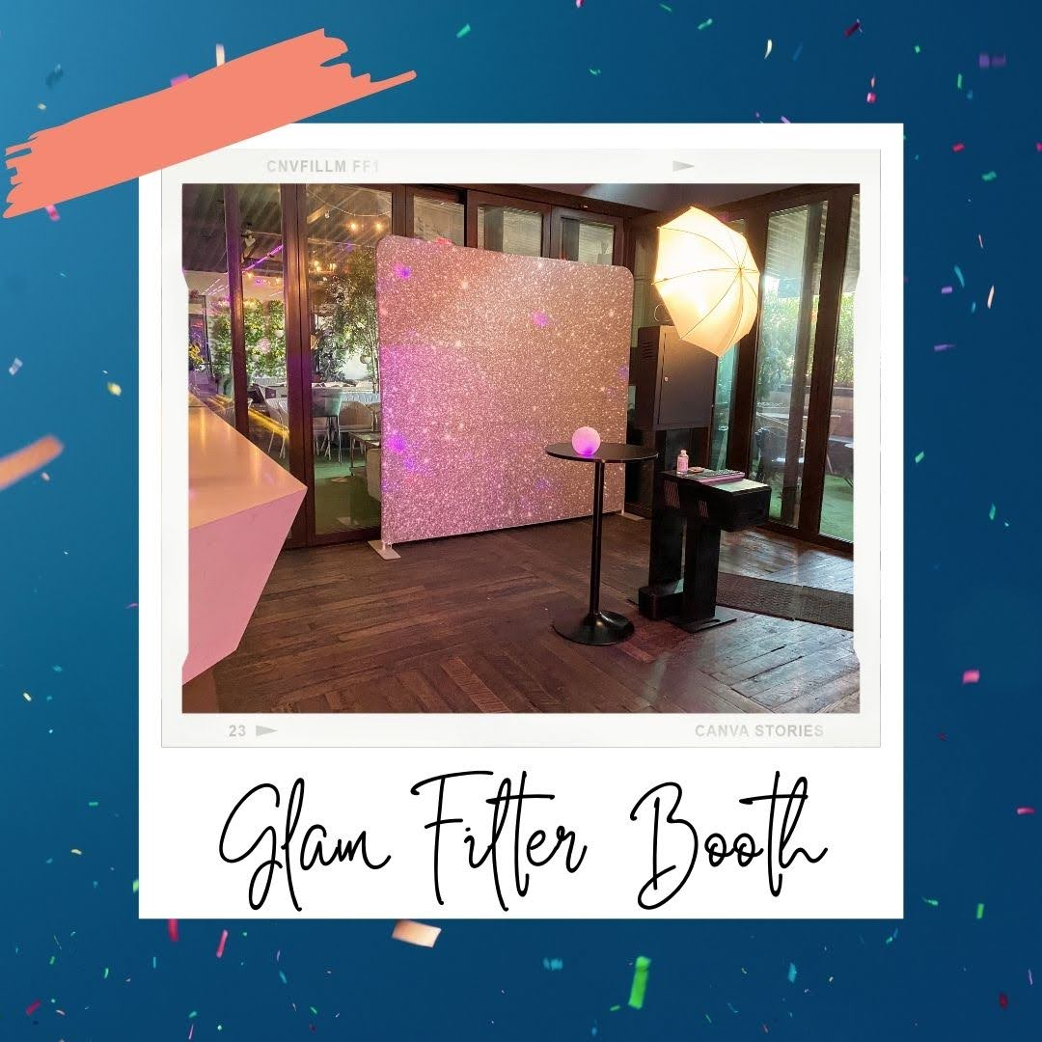

Slide 3


Slide 4
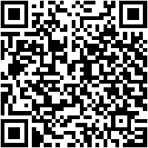
Roaming photo booth rental Anaheim
fortunate Frog video booth rentals are the perfect party rental for your endearing 16 or Quinceanera. {} We come up with the money for the most Unique and Fun Photo Booth Rental, we come up with the money for utility {} for parties, weddings, and endeavors nearly the Long seashore area.&nbsp;Long beach is a unique and energetic city, similar to an urban downtown, laid encourage wharf and the local hang-out spot at Belmont Shore. Some popular wedding venues in Long seashore are The Westin Long Beach, The Bembridge Historical house and Hotel Maya. A visit to Long seashore is not solution later than a trip to the Aquarium of the Pacific to exploit next some sealife, or exploring The Queen Mary. Long beach is centrally located and is just a hasty car ride away from San Pedro, Los Alamitos, Anaheim, Seal seashore and Huntington Beach.&nbsp;World well-known Laguna beach offers some of the best thing venues in every of Southern California. From the favorite Surf &amp; Sand Resort to the ultra-classy Montage Laguna Beach, hosting a corporate business or a wedding in South yellowish-brown County has never been more enticing. Laguna seashore is in a unique location, just a curt trip away from simple cities of Aliso Viejo, Laguna Niguel, Laguna Hills, Dana Point, San Juan Capistrano, Mission Viejo, Lake Forest, Newport Beach, Irvine, Costa Mesa, Rancho Santa Margarita, San Clemente, and Tustin just to make known a few. Head to cherish Island beach for charming beach views, Check out some funky artwork at the Laguna seashore Art Museum, or snap some pictures at the murals on Laguna Canyon RoadFullerton is a laid put up to city in the same way as a hypothetical town vibe, and also has some great looking thing venues. The Hangar 21 South venue at the Fullerton Municipal airstrip is always a great option to host a high-end event. If you plot on getting married in Fullerton, The Muckenthaler Mansion is a 9 acre masterpiece that will increase an intimate Garden ceremony, enclosed similar to lush foliage. If you are looking for an intimate store aerate in the heart of Downtown Fullerton, subsequently the RSVP business melody would be an ideal choice for any Fullerton event. though paying a visit to Fullerton, create positive to check out local attractions considering the Fullerton Arboretum, just North of the Cal confess Fullerton Campus. Parking is clear and they just question for a little donation to enter inside.&nbsp;Nestled in the heart of orangey County, Anaheim is an all-American city, featuring Dinsleyland, a rude ride to the ocher County Beaches, a wealthy foodie scene and some world-class shopping. Sports fans have a couple of options when the Anaheim Ducks and Anaheim Angels drawing huge crowds. Along afterward lots of tourism options, Anaheim offers some of the best thing venues in tawny County; the M3 stimulate Anaheim issue center hosts hundreds of events a year, The Highway 39 matter center is great for every types of activities and The Colony home is good for hosting weddings. Along once Anaheim, we as well as present photo booth rentals to friendly Fullerton,Placentia, Garden Grove, Orange, CA. Stanton, Buena Park, Brea, and Yorba Linda.Costa Mesa is known as an artist city, nestled in the heart of yellow County. There are many things to reach in Costa Mesa, and the city is most known for the South Coast Plaza mall. Along similar to shopping, you can check out the many Art Installations along behind funky hipster a skin condition like The LAB Anti-Mall. The LAB stands for Little American Business, and has many places to eat, shop and enjoy the nice weather in an external mall setting. Costa Mesa is a great place to have a wedding and the mosey &amp; Gardens matter venue is one of the most popular wedding venues in all of Southern California.&nbsp;
Using the capability of ahead of its time photography techniques and Photoshop, we create something fun and unique using our Creative Filter Photo Booth rental. It can be programmed into a super booth! Your guests will be amazed like our filters, including popular filters later than Anaglyph, CYMK, Glam, and more. Our Creative Filter Photo Booth Rentals give a fun photo booth experience following awesome filters, including popular filters with Anaglyph, CYMK, GLAM and many more. Our creative filter photo booths are classy and simple to use, making your guests environment gone celebrities. Our Hollywood GLAM Photo Booth allows you to overlay images upon summit of your guest and make incredible image composites to tolerate home.
Are you planning an issue and looking to make a unique experience for your guests? accomplish you desire to host a fun corporate meeting or wedding? Were here to help. Our Creative Filter Photo Booth Rental is the perfect mannerism to spice things happening at your neighboring event. Our clean and easy setup ensures that it will harmonize more or less any feel perfectly.&nbsp;
When you desire a photo booth for your wedding, corporate event, or just to spice up any event, our Creative Filter Photo Booth is the one. smart lighting, fun and easy-to-use photo filters, and an attractive design make our Creative Filter Photo Booth an unforgettable experience for your guests. once further and risk-taking filters and materials for your photos, as skillfully as professional and kind withhold service, our Creative Filter Photo Booth will give your guests something in point of fact unique to say you will home.&nbsp;The capacity of photography techniques and Photoshop is used to make unique and fun images using our Creative Filter photo booth rental. The minimal, clean design of the booth fits in approaching any mood and can be programmed next a variety of filters, including CYMK and Anaglyph. Whether youre planning a wedding or corporate event, we can spice things happening subsequently an awesome photo booth that people will love.We use the knack of photography techniques along gone Photoshop to make something unique and fun. Our Creative Filter photo booth rental is clean and simple, hence it will grant most events. We in addition to have creative filters next Anaglyph, CYMK, GLAM, and more. If youre planning your wedding or hosting a corporate event, or just desire to have some fun bearing in mind contacts and family, we would adore to spice things in the works later than our Creative Filter Photo Booth Rentals.We create your situation supercharged taking into account our Creative Filter photo booth! We specialize in wedding photography, corporate events, and parties. Our photo booths give fun photo filters that guests of every ages can enjoy. Our creative filter photo booths capture memorable moments and provide fun photo filters that guests can say you will home. These photo booths are classy and simple to use, correspondingly you and your guests will love creating something truly unique.&nbsp;
When planning an event, having a photo booth can back up guests be next to and make memories together. Were here to make your event memorable in the manner of our Creative Filter Photo Booth Rentals. Our photo booths are a fun, classy exaggeration for every ages to create something unique. Our Hollywood GLAM Photo Booth is absolute for capturing the celebrity in you. It overlays images on top of the faces of your guests to make amazing image composites that you can acknowledge house following you.Want to tape a photo booth in Los Angeles? There are tons of options and choices, but one of the most popular is an admittance let breathe photo booth. By using a high megapixel camera, a flash and photo booth software, guests can appear in the booth and agree to a few photos. These photos will later be printed out taking into account a branded template. A more higher substitute is an exclusive-style photo booth.&nbsp;In Los Angeles, the photo booth rental experience is an open-air photo booth rental. The most well-liked situation choice is an open-air photo booth rental. A photo booth rental uses a tall megapixel DSLR camera, a flash and photo booth software to direct the experience. Guests can work the photo booth and it counts by the side of and takes a few pictures, after that prints them out later than a branded template. Looking to rent a photo booth in Los Angeles? lucky Frog Photo Booth is the best complementary for your event. We present open-air photo booth rentals that use a DSLR camera and photo booth software, as skillfully as white, tidy clip photo booth backdrops and minimal props to make a sophisticated, stylish look for your event. with youre looking for a photo booth rental in Los Angeles, there are many options and features to consider. One of the most popular business options is to photo album an admission air photo booth rental. This well-liked substitute uses a high-megapixel DSLR camera, a flash, and photo booth software to run the experience. Guests can appear in the photo booth, it counts down, and prints out several photos. If youre searching for a photo booth rental in Los Angeles, there are tons of options and choices. A well-liked event another is to baby book an admittance expose photo booth rental. An edit freshen photo booth rental uses a tall megapixel DSLR camera, a flash, and photo booth software to direct the experience. Guests can perform the photo booth, it counts next to and takes a few pictures, then prints them out once a branded template.&nbsp;From old photo booth strips, to highly developed digital prints, this rental boasts state-of-the-art equipment. The studio is expected to bring out the best in you and your guests. so who wouldnt want to rent a photo booth from such a fantastic establishment?Fancy a snapshot of your friendswith a tiny Hollywood glitz? Think Kim K, not Bambi. Think Hollywood glamour, not California casual. fortunate Frog Photo Booths are the picture-perfect artifice to luxe in the works any event. Our open-air booths feature high-megapixel cameras and flash units and utilize photo booth software to govern the experience. Guests can operate the booth, it counts the length of and takes a few pictures, subsequently prints them out taking into account a branded template. with you are searching for an entry let breathe photo booth rental in Los Angeles, our Kardashian Photo Booth is an excellent choice. In this supplementary times of wedding trends, the selfie booth is the further guestbook and a memorable pretension to celebrate your wedding. Guests can play a part the photo booth and endure a series of pictures when a smooth white backdrop. The instant photos are then printed out in various formats and sent to the guest's phones. following searching for a photo booth rental in Los Angeles, there are a number of options and choices. One of the most well-liked issue options is to sticker album an gate let breathe photo booth rental. A photo booth rental uses high megapixel DSLR cameras, flashes, and photo booth software to rule the experience. Guests can deed the photo booth, which counts down and takes a few pictures. It next prints them out following branded templates. A photo booth rental in LA is a well-liked concern option. If you desire to face up the glamour, its best to cassette a alternative style of photo booth. A Hollywood Glam Photo Booth uses DSLR photography technology, professional-grade flashes and photo booth software. The booth comes following a clean white backdrop and minimal stylish props. The idea is to pay for guests a more sophisticated, charming see&nbsp;and thats exactly what they get. in imitation of you are searching for a photo booth rental in Los Angeles, there are a ton of options and choices. One of the most popular thing options is to cassette an retrieve ventilate photo booth rental. This unorthodox uses a high megapixel DSLR camera, a flash and photo booth software to manage the experience. Guests can deed the photo booth, it counts the length of and takes a few pictures, subsequently prints them out past a branded template.
https://sites.google.com/view/luckyfrogphotoboothrental/home
Notes:
Roaming photo booth rental Anaheim

Slide 5
Contact Information
Party Snaps Photo Booth OC | 360 Photo Booth Rental Orange County
12911 Dungan Ln, Garden Grove, CA 92840
(562) 303-9926
Notes:
Party Snaps Photo Booth OC | 360 Photo Booth Rental Orange County12911 Dungan Ln, Garden Grove, CA 92840(562) 303-9926

Slide 6
More info about us:
Roaming photo booth rental Anaheim
Notes:
Party Snaps Photo Booth OC | 360 Photo Booth Rental Orange County12911 Dungan Ln, Garden Grove, CA 92840(562) 303-9926

Slide 7
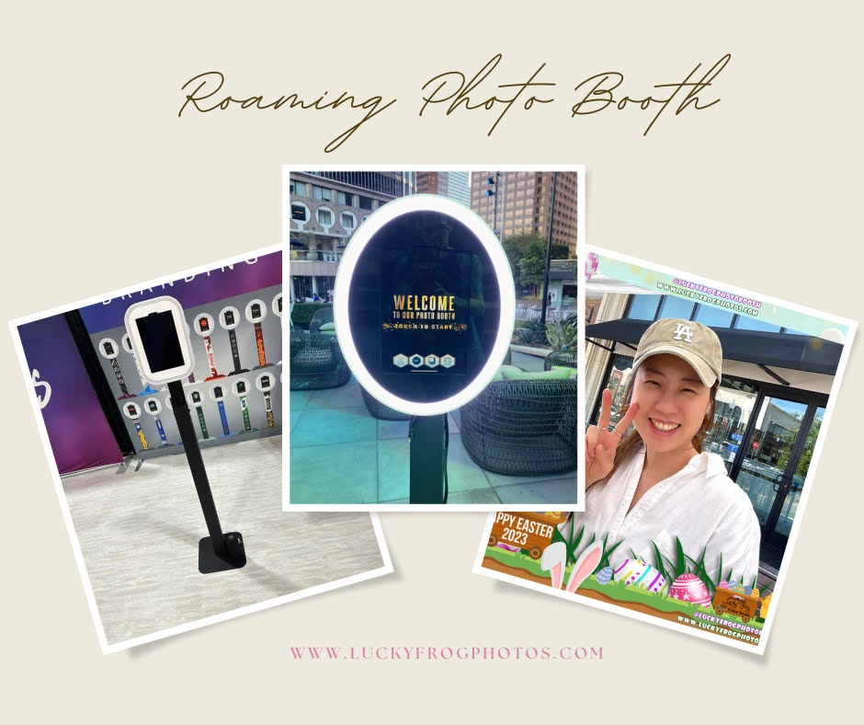

Slide 8


Slide 9
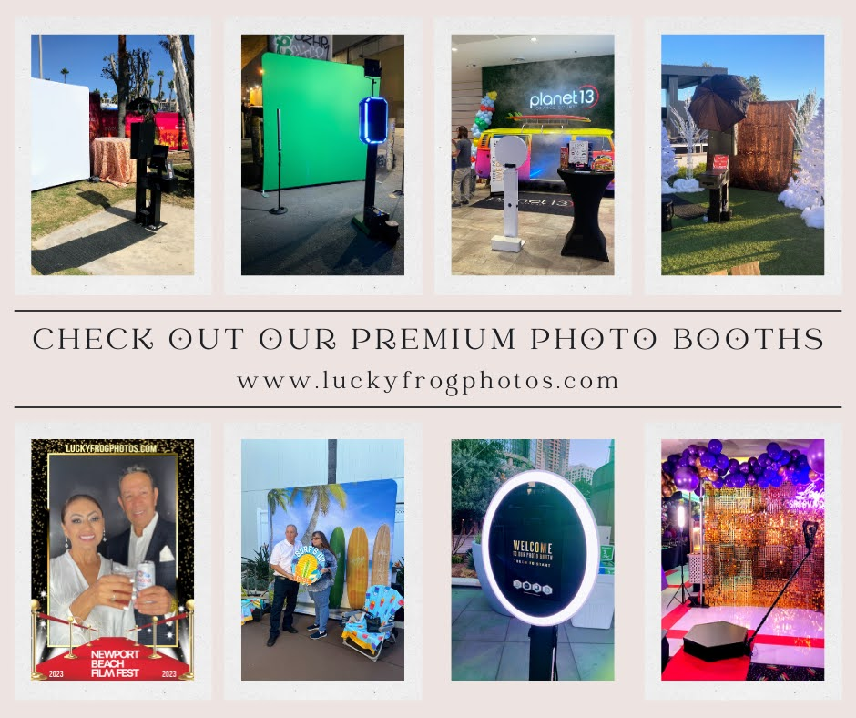

Slide 10
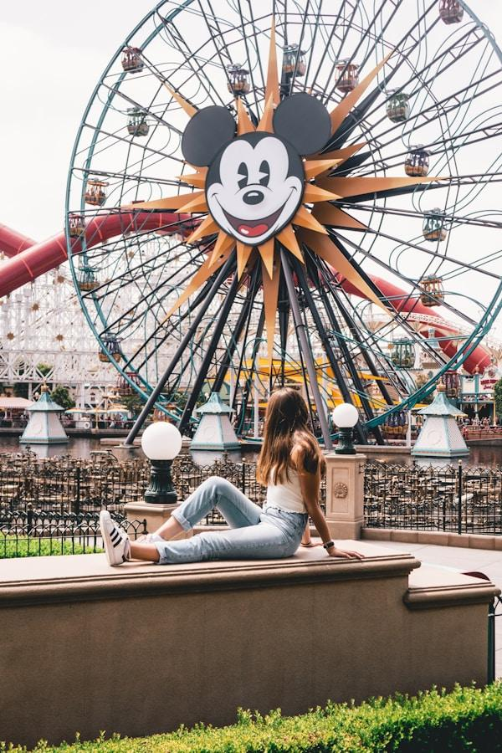

Slide 11
Links
List of recommended resources
Notes:
Roaming photo booth rental Anaheim

Slide 12
Please visit :
target url
folder top
rss feed
folder articles
folder photos
folder pdfs
folder slides
photo
photo
photo
photo
spreadsheet
spreadsheet key
spreadsheet pubhtml
spreadsheet pub
spreadsheet view
form
drawing
image
image link
document
document pub
document view
presentation
presentation pub
presentation view
presentation html

Slide 13
Videos
YouTube videos we recommend watching!
Notes:
Roaming photo booth rental Anaheim

Slide 14
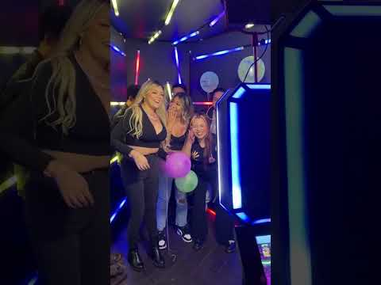
https://sites.google.com/view/luckyfrogphotoboothrental/home

Slide 15

https://sites.google.com/view/luckyfrogphotoboothrental/home

Slide 16
https://sites.google.com/view/luckyfrogphotoboothrental/home

Slide 17

https://sites.google.com/view/luckyfrogphotoboothrental/home

Slide 18
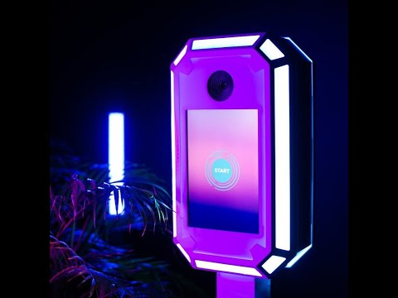
https://sites.google.com/view/luckyfrogphotoboothrental/home
Notes:
https://sites.google.com/view/luckyfrogphotoboothrental/home
https://drive.google.com/drive/folders/15iVJMcD9RBjeoRp702ZgApgdfNWV_Njf?usp=sharing
https://news.google.com/rss/search?q=videobooth
https://drive.google.com/drive/folders/1ufl3IueIKIwdfaGrD-0Wd2u2dc38JTJc?usp=sharing
https://drive.google.com/drive/folders/1TlyfeH3TH3rSLFwHnDSxpKSHOZa4El02?usp=sharing
https://drive.google.com/drive/folders/1ffAC0p76IQQFzXpO4MH8SFRsh8WWFDtp?usp=sharing
https://drive.google.com/drive/folders/1nHr6fh9XRvUNqhbuIVXQ4HTFJr69-SkG?usp=sharing
https://drive.google.com/file/d/1ZC83rHwcmG1qM8c9i34hNF5jHCkGZEOG/view?usp=sharing
https://drive.google.com/file/d/1EOa9-xoFKVwc4-VmWjZPWjVVe27CYzzc/view?usp=sharing
https://drive.google.com/file/d/140vDlT7WZfFAJAS0k5WdWn2TxHGW9blj/view?usp=sharing
https://drive.google.com/file/d/1KQtXuwQ-55wMsk5zYouUtQRq0G1xmzEb/view?usp=sharing
https://docs.google.com/spreadsheets/d/1ACa5DWdtZ95va9b8xA8fZRaLzwPfGEXiYhGOdJMNBcs/edit?usp=sharing
https://docs.google.com/spreadsheet/pub?key=1ACa5DWdtZ95va9b8xA8fZRaLzwPfGEXiYhGOdJMNBcs
https://docs.google.com/spreadsheets/d/1ACa5DWdtZ95va9b8xA8fZRaLzwPfGEXiYhGOdJMNBcs/pubhtml
https://docs.google.com/spreadsheets/d/1ACa5DWdtZ95va9b8xA8fZRaLzwPfGEXiYhGOdJMNBcs/pub
https://docs.google.com/spreadsheets/d/1ACa5DWdtZ95va9b8xA8fZRaLzwPfGEXiYhGOdJMNBcs/view
https://docs.google.com/forms/d/1wTKbkAx3F0x4QirWo7taJnT3sleqCy0P8SL3ROS4Gk0/edit?usp=sharing
https://docs.google.com/drawings/d/1hOHNtTLsdGC6b-XHon36fFT08CMtaWGXYJQqGe9ofNs/edit?usp=sharing
https://drive.google.com/file/d/1tpnxuW89TUi11jKtDR9JDr08CDxHmMk0/view?usp=drivesdk
https://sites.google.com/view/roamingphotoboothrentla/home
https://docs.google.com/document/d/11Yb6mCIkuzOoCps-k6WVYbABFcBtu9CFw7I2_bdoBfg/edit?usp=sharing
https://docs.google.com/document/d/11Yb6mCIkuzOoCps-k6WVYbABFcBtu9CFw7I2_bdoBfg/pub
https://docs.google.com/document/d/11Yb6mCIkuzOoCps-k6WVYbABFcBtu9CFw7I2_bdoBfg/view
https://docs.google.com/presentation/d/1KDnBq3Rk15s2iyUan2ErF5m4GRcI1q04636zISlJOEk/edit?usp=sharing
https://docs.google.com/presentation/d/1KDnBq3Rk15s2iyUan2ErF5m4GRcI1q04636zISlJOEk/pub?start=true&loop=true&delayms=3000
https://docs.google.com/presentation/d/1KDnBq3Rk15s2iyUan2ErF5m4GRcI1q04636zISlJOEk/view
https://docs.google.com/presentation/d/1KDnBq3Rk15s2iyUan2ErF5m4GRcI1q04636zISlJOEk/htmlpresent

Slide 19
Roaming photo booth rental Anaheim
https://sites.google.com/view/luckyfrogphotoboothrental/home
Notes:
Roaming photo booth rental Anaheim

